Slide 1




Net-Centric Programming
A Wonder Worlds Game Project
Vũ Nhật Duy - ITITIU17047

Slide 2
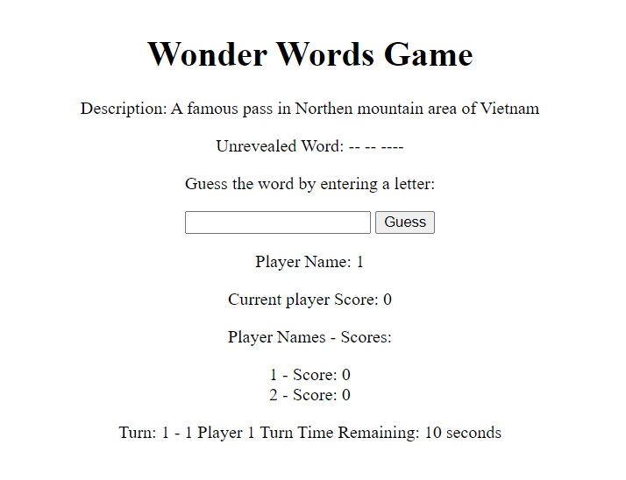
Table of contents
Introduction
Architecture
Game Play
Diagrams
Demonstration
Future Improvements

Slide 3


Introduction
Background of the Project
Wonder Words Game
Server-client Web socket Architecture
Purpose and Significance
Emulating the game
Learned knowledge Implementation

Slide 4

System Architecture
Server
Architecture
Web Socket
Client (Web Browser)

Slide 5
Components
Game Manager
Architecture
Word Selector
Guess Verifier
Score Calculator

Slide 6






Gameplay
Players guess a hidden word
Scores based on guesses
Until word is revealed
Turn-based system

Slide 7
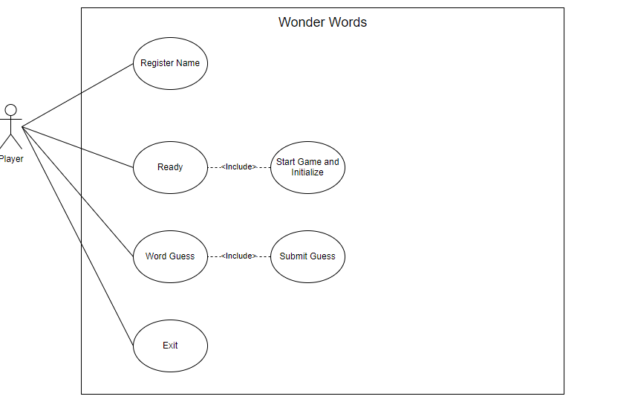
Use Case Diagram

Slide 8
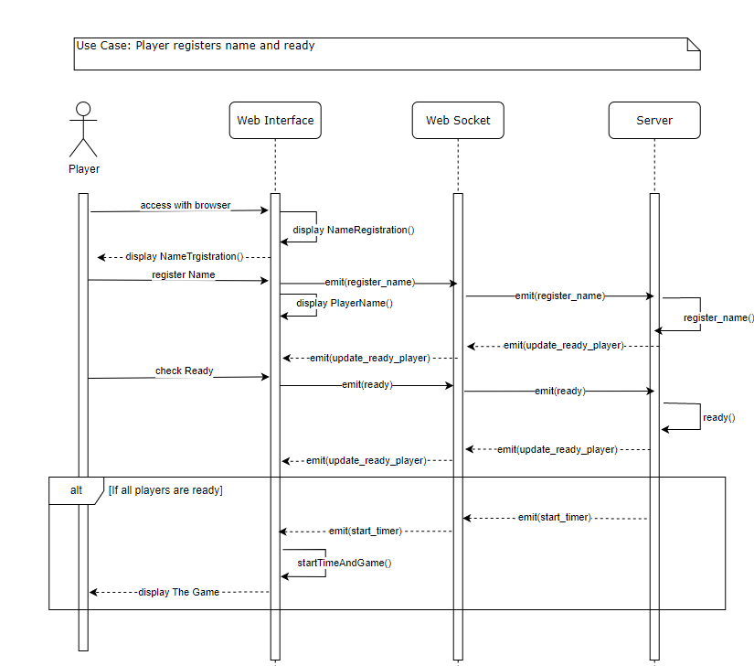
Sequence Diagram

Slide 9
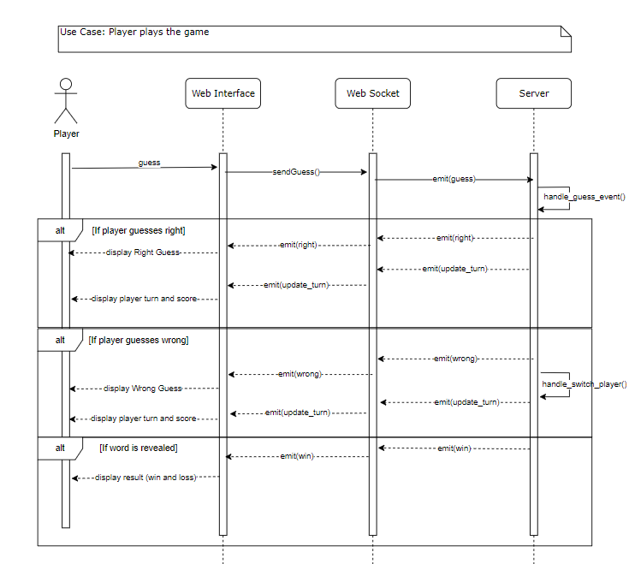
Sequence Diagram

Slide 10




Tools and Technologies
Python
Flask
HTML
Javascript
Others

Slide 11

Future Improvement and Enhancements
Enhanced Chat Functionality
Moderation Tools
Direct Messaging
Player Account Enhancements
Global Chat
Game Room Customization

Slide 12





Conclusion
Summary of Achivements
Lessons Learned
Conclusion
Successful establishment of an online presence:
Seamless shopping experience:
Integration of essential features:
Enhanced customer engagement:
Clear and defined project scope:
Customer-centric approach:
Robust analytics and reporting:
The completion of the website project has significance impact and potential benfits

Slide 13


THANK YOU
Any questions?

